Slide 1
Social Behavior Inference and Interaction Mapping using mmWave Radar
Md Fakhrul Alam
Graduate Student
Advisor: Dr. Veena Chidurala
Electrical & Computer Engineering

Slide 2
Outline
Introduction
Problem Statement
Literature Review
Research Goal
mmWave Radar Fundamental
System Design/Model
Sensor Setup
Data Acquisition
ML Model
Feature Vectorization
Training
Simulation ( platform, parameters)
Preliminary Results
Future Results
References

Slide 3
Introduction

Slide 4
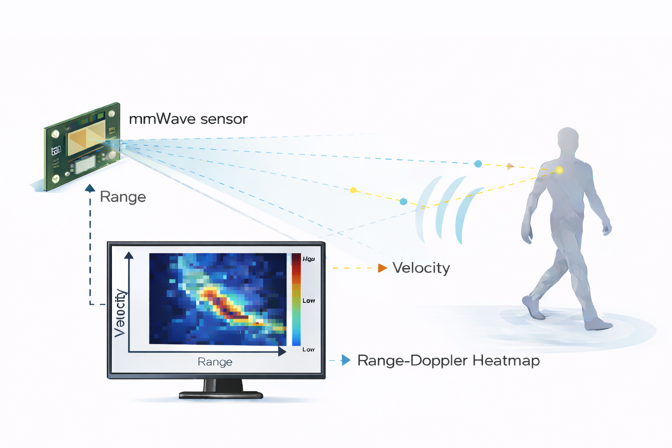
Introduction
mmWave Radar Sensors
High frequency sensing technology detects human motion and position by analyzing reflected radio waves
Applications
Healthcare monitoring , smart home occupancy sensing, security and surveillance systems, robotics or autonomous navigation, etc.
Advantages
Privacy- preserving
Environmental Flexibility
Micro motion Detection

Slide 5
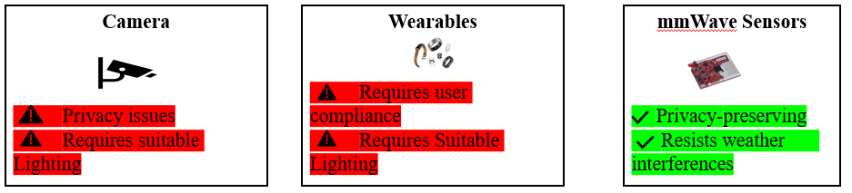
Introduction – mmwave radar on HAR
• Human Activity Recognition (HAR): Automatic identification of human actions such as walking, sitting, standing, and gestures
Crucial for elderly assisted living, fall detection, healthcare monitoring, and safety application
Available Sensing Technologies: Camera, Lidar, Wearable, Radar, etc.

Slide 6



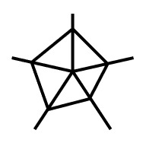


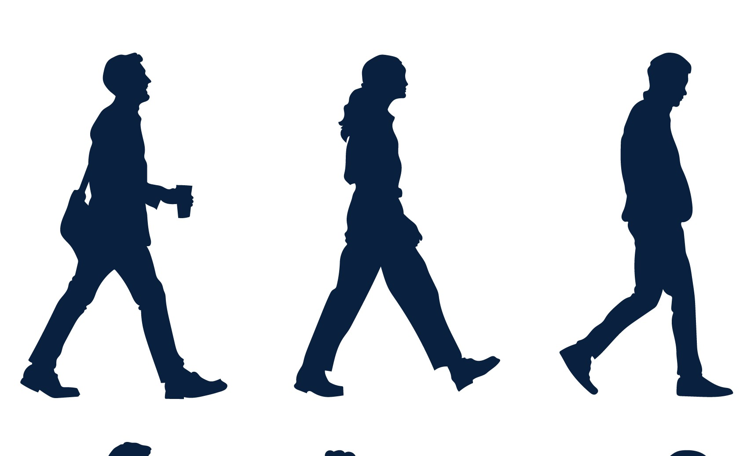

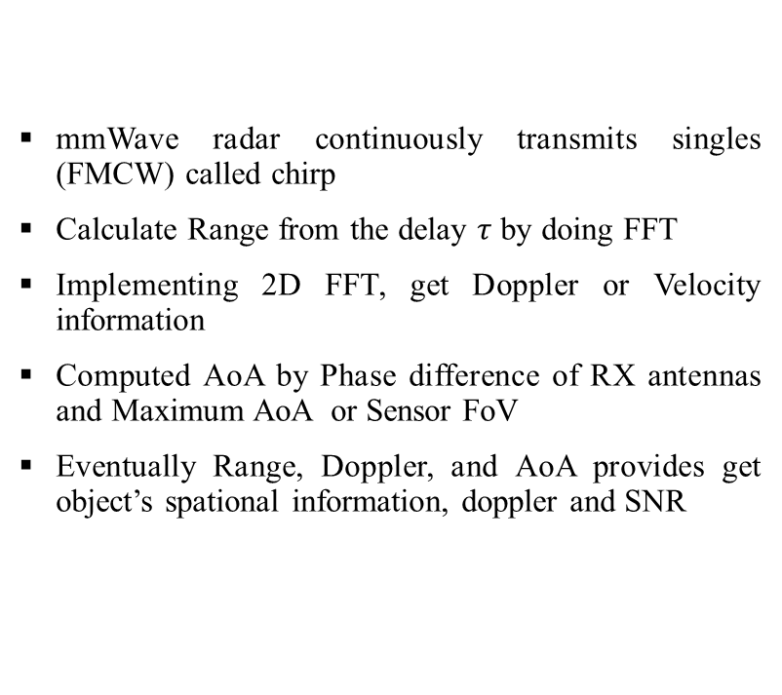
Introduction
Preprocessing and Applying ML Model
mmWave radar continuously transmits singles (FMCW) called chirp
Calculate Range from the delay $τ$ by doing FFT
Implementing 2D FFT, get Doppler or Velocity information
Computed AoA by Phase difference of RX antennas and Maximum AoA or Sensor FoV
Eventually Range, Doppler, and AoA provides get object’s spational information, doppler and SNR
Human data acquisition
Predicted Social
Interaction
Group Sitting
Group Walking
Group Standing
Figure : Predicting social behavior in a smart space

Slide 7
Problem Statement
Current Systems:
Single person activity
Used vision-based sensors
User discomfort, lack of privacy
Research Gap:
No robust system using mmwave radar to predict multi-person social beahvior

Slide 8
Literature Review
Study | Methodology | Findings | Comments
Abdullah et al. 2024 [1] | They used IWR6843ISK-ODS connected to an NVIDIA Jetson Nano and Collected individual human subject’s positional (x, y, z), doppler and acceleration data. PointNet model was used in recognizing five types of activities: standing, walking, sitting, lying, and falling | They achieved very good accuracy of 99.5% | Their data isn’t robust to real time scenario as they used radar data after group tracking algorithm. Only recognize single person’s activity
Z. Li et al. 2023 [2] | Used micro-Doppler signatures with an adaptive magnitude thresholding method to highlight Region of Interest (RoI). Tested on six different human activities. Compared to state-of-the-art deep learning methods, measured improvement in computation time & inference cost | Achieved about 93.1% accuracy. Reduced training time, memory footprint, and inference cost | Focused on efficiency and individual motion types. Not explicitly about social/group behavior

Slide 9
Literature Review
Study | Methodology | Findings | Comments
F. Jin et al. 2019 [3] | Used a TI AWR1642BOOST mmWave FMCW radar with point cloud and Doppler data to classify walking, falling, swinging hand for help, seizure, restless movement, and other behaviors in a two-patient hospital-like setting | They used PC for tracking patients and separation while doppler spectrograms used for 3-layer CNN inputs | Though designed critical healthcare monitoring for two persons, not for general social behavior understanding

Slide 10
Research Goal

Slide 11
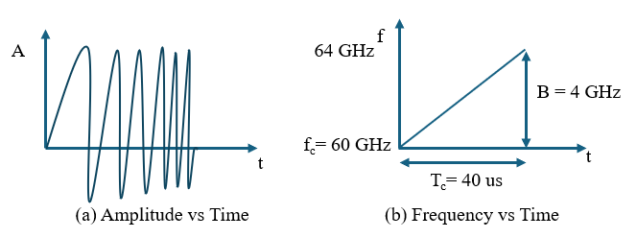
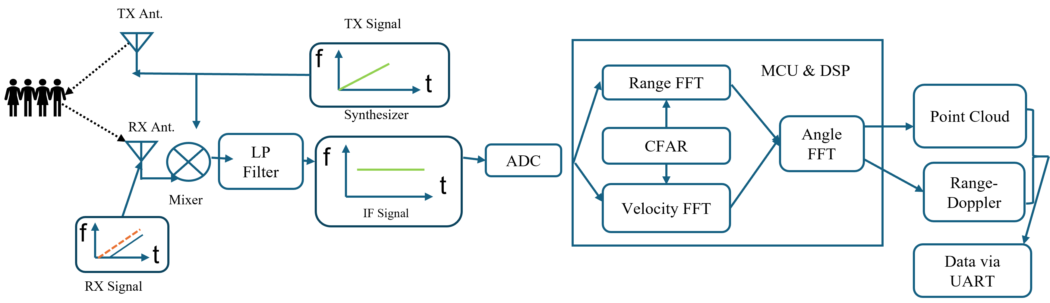
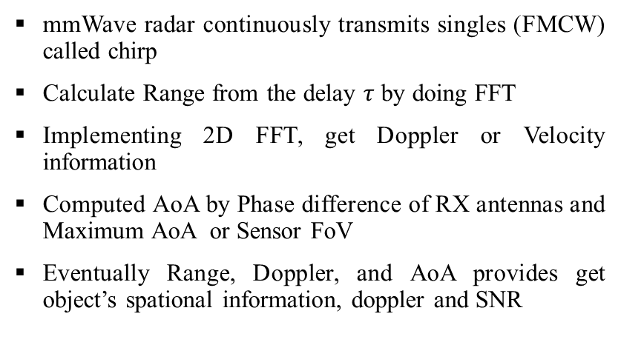
mmWave Radar Fundamental
mmWave radar continuously transmits singles (FMCW) called chirp
Calculate Range from the delay $τ$ by doing FFT
Implementing 2D FFT, get Doppler or Velocity information
Computed AoA by Phase difference of RX antennas and Maximum AoA or Sensor FoV
Eventually Range, Doppler, and AoA provides get object’s spational information, doppler and SNR
Figure 2: mmWave Radar Fundamental

Slide 12
Sensor Setup
Download mmwave SDK (V 3.5.0.0) for necessary bin files and source code
Flashing TI prebuilt firmware (e.g. 3D people Tacking) using
UniFlash software
Wrote the cfg file according to environment and exp setup
Get the UART raw data as bytes. Get preferred TLV data according to experiment (e.g. Point Cloud, Track Data)
Use own custom-made python script for parsing data

Slide 13
Sensor Setup (Configuration Parameter)
Parameter | Value
Frequency | 60.75 GHz
Bandwidth | 1.47755 GHz
Chirp Duration | 55 us
Frame Rate | 18.18 Hz
Field of View | 70° (Azimuth), 20° (Elevation)
Number of Antennas | 3 (TX), 4(RX)
Range Regulation | 10.1 cm
Unambiguous Range | 7.49 m
Doppler Resolution | 0.47 m/s
Unambiguous Doppler Velocity | ±22.5 m/s
ADC Sampling Frequency | 2.95MHz

Slide 14
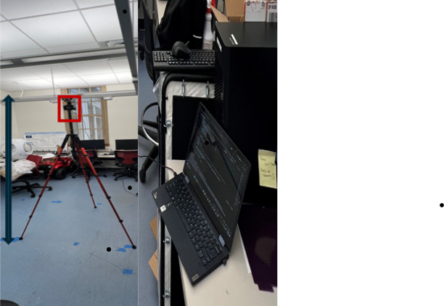
Experimental Setup
IWR6843ISK mounted with Tripod at 2 m High and 15° down-tilt
Dual UART via Micro USB, Baud rate for CLI @115200 and Data @921600
IWR6843ISK Operates with 5V DC and 3A
Data Acquisition

Slide 15
Raw Data Structure
Frame Header
(40 Bytes)
TLV1
TLV2
TLV2
------------
Point Cloud
Target List
Associated Points
Helps to identify correct TLV payload to parse data
Variable Number of TLVs
In our exp parsed TLV 1000 is PointCloud
This gave us object spatial position (x, y, z), doppler and SNR data
We parsed also TLV 1010 i.e., Target List
Got Data as Jason format. Header gave us sequential frameNum and timestamp
Target ID, X (m), Y (m), Z (m), X_vel (m/s), Y_vel (m/s), Z_vel (m/s), X_acc (m/s²), Y_acc (m/s²), Z_acc (m/s²), G (tracking state), confidence level]

Slide 16
System Design
Sensor Setup
Data Acquisition
Feature Vectorization
Model
Preparation
Preliminary Result

Slide 17
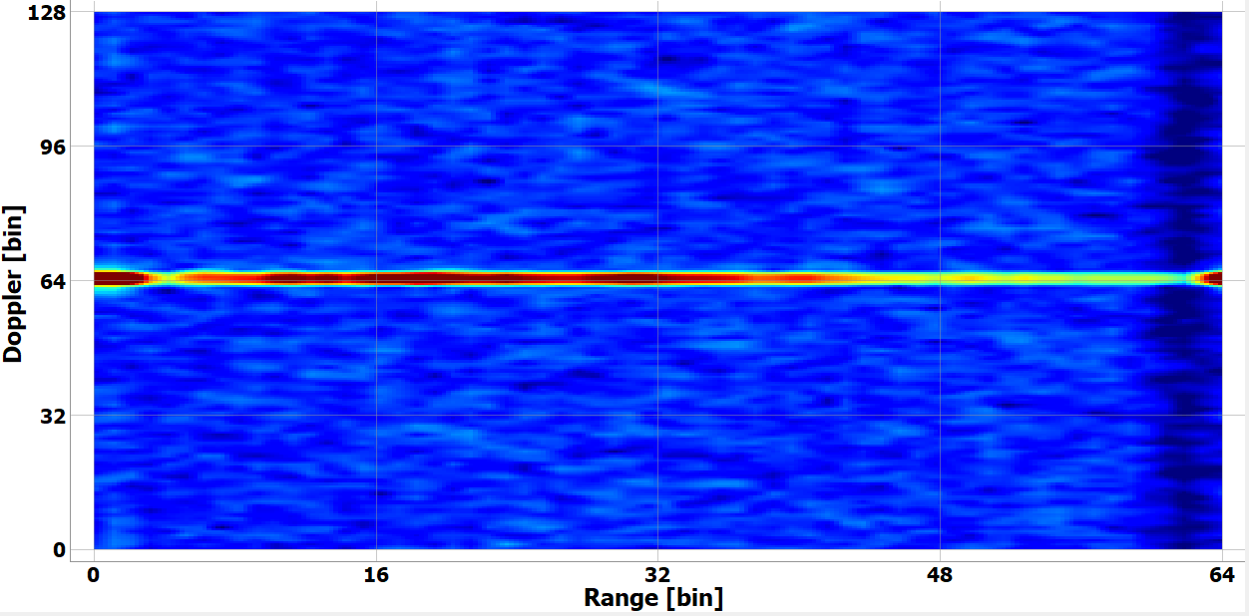
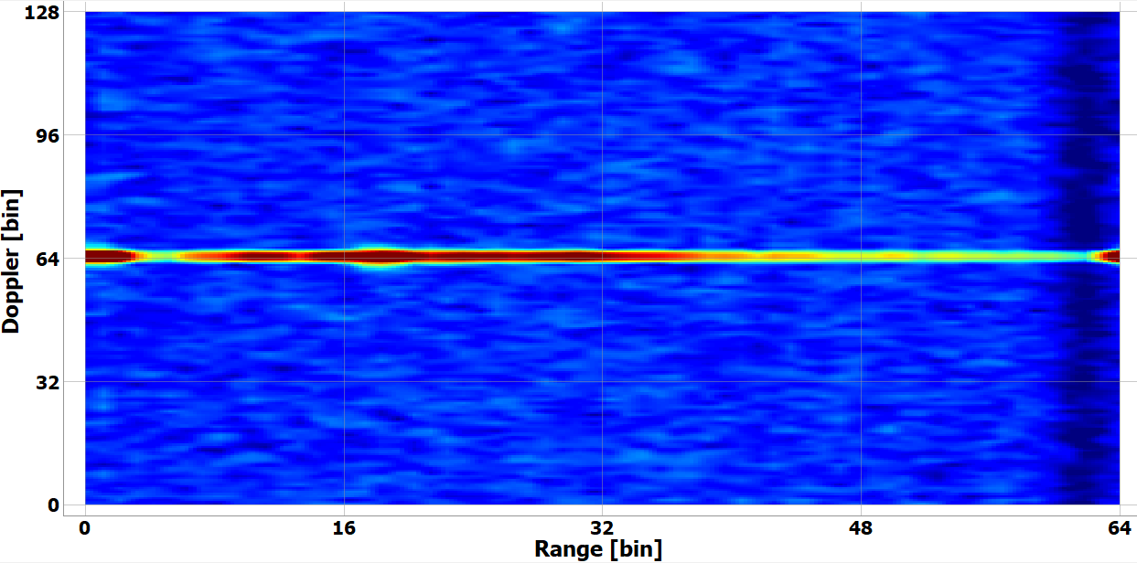
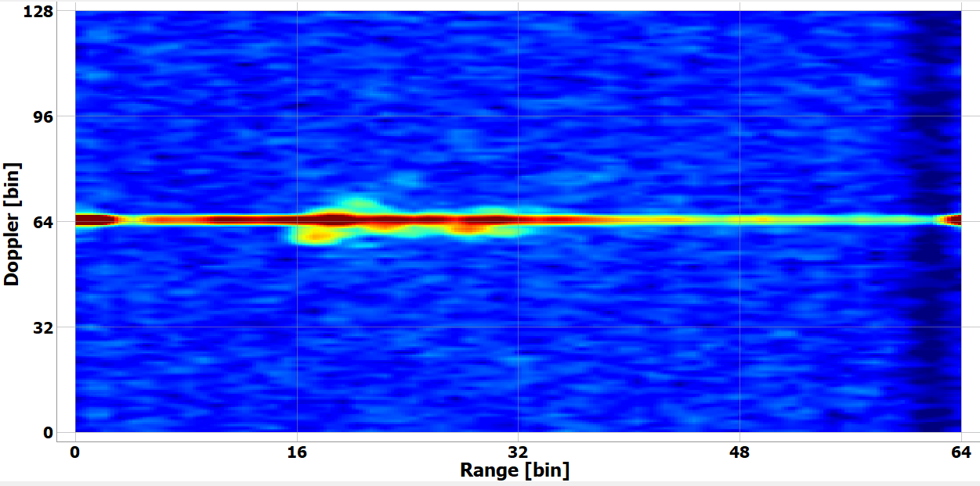
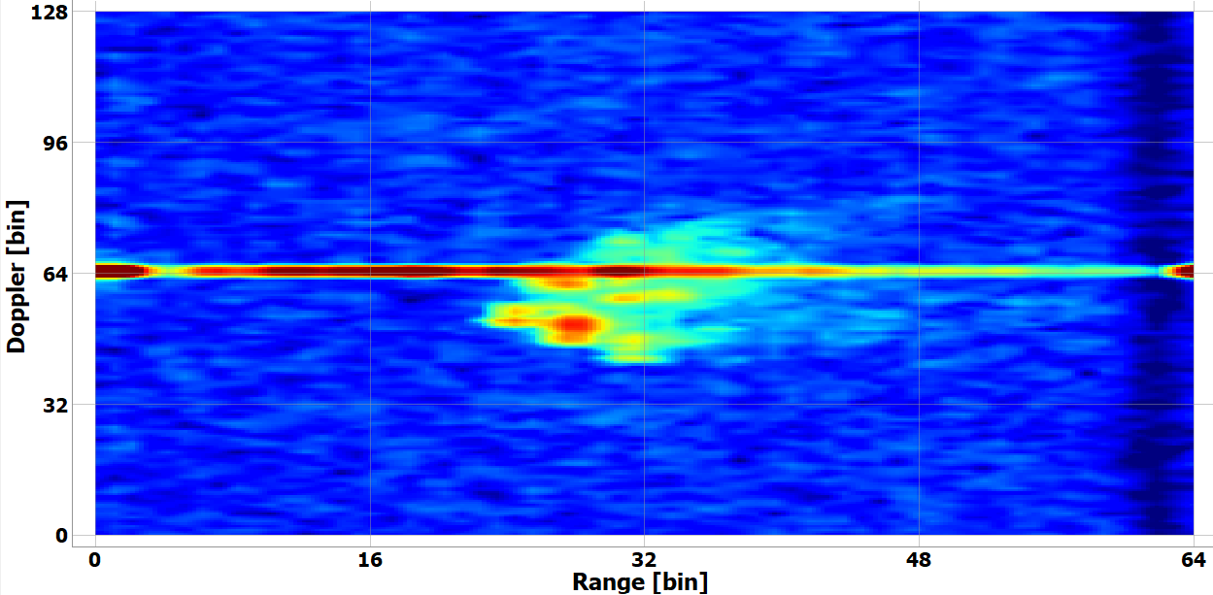
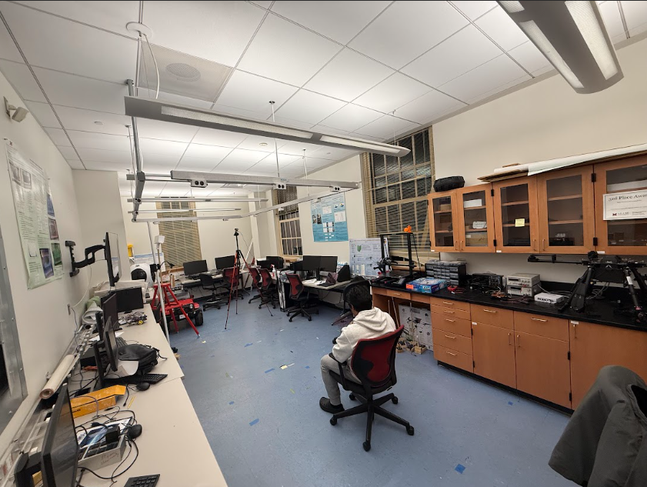
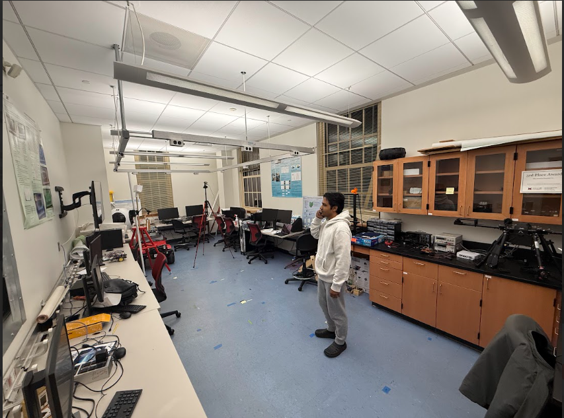
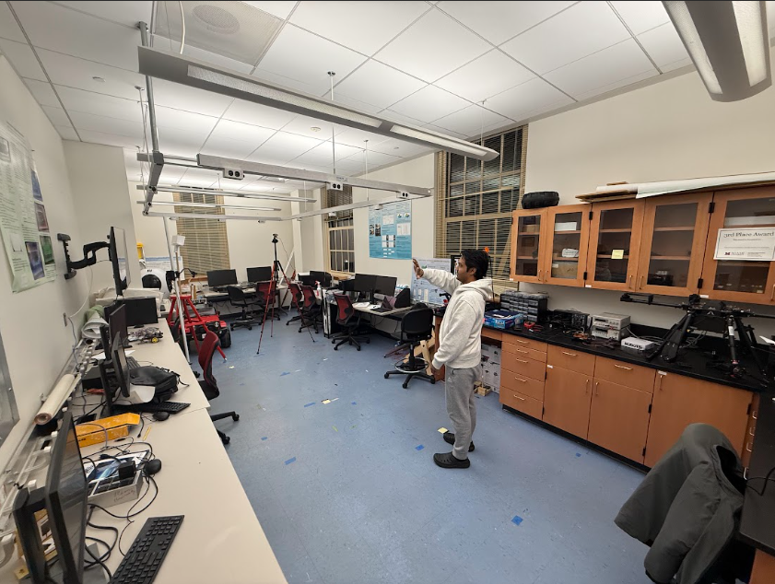
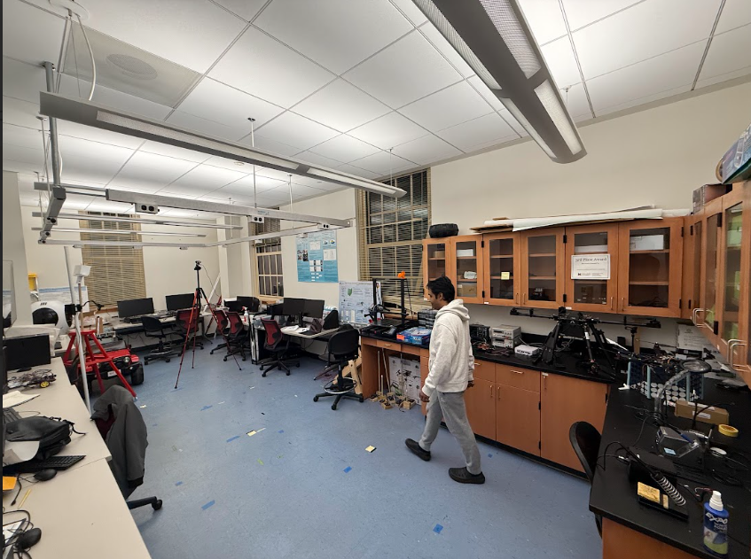
Single Activity Recognition (Range-Doppler)
Sitting
Standing
Waving
Walking
Fig: Illustration of four single activity and their samples of range-doppler spectrum

Slide 18
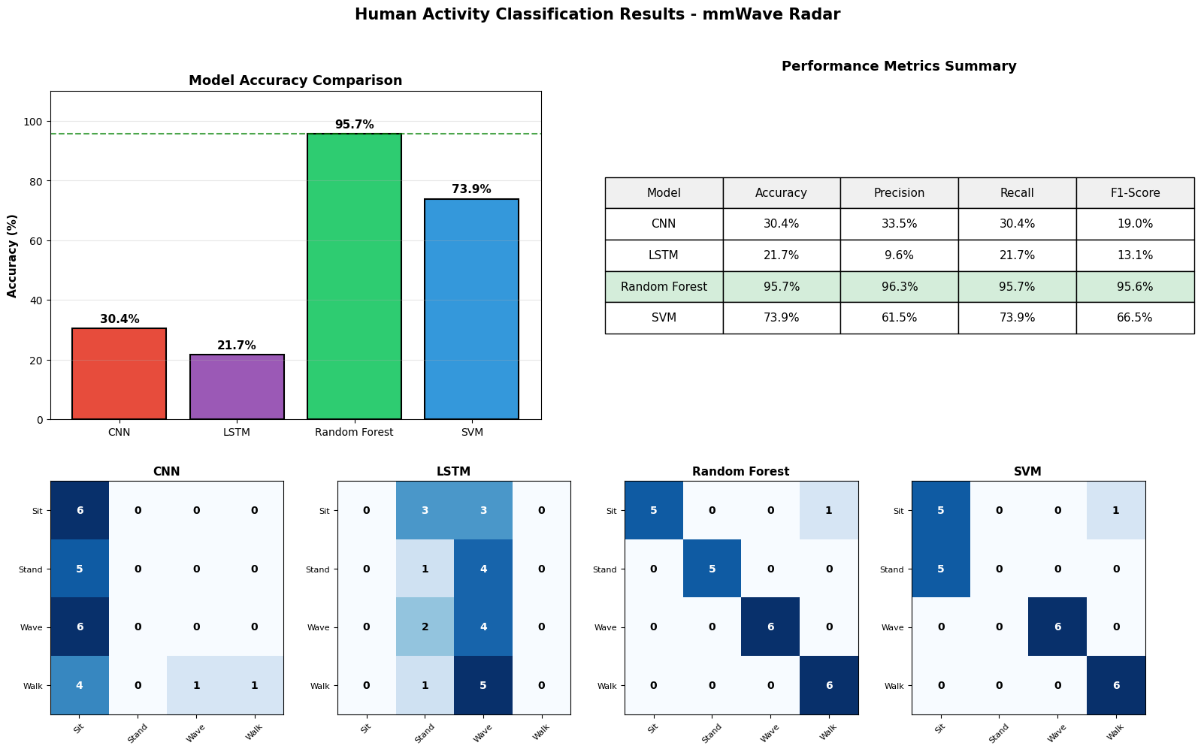
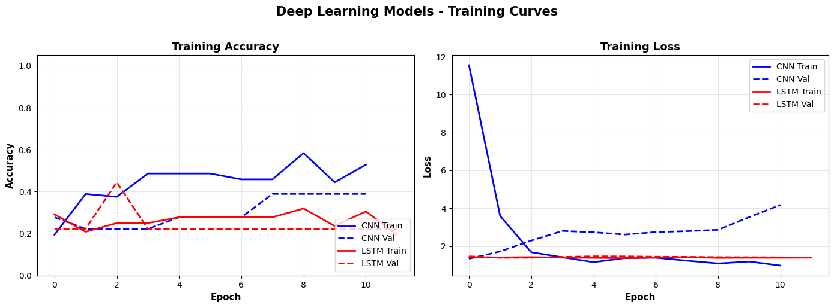
Preliminary Result

Slide 19
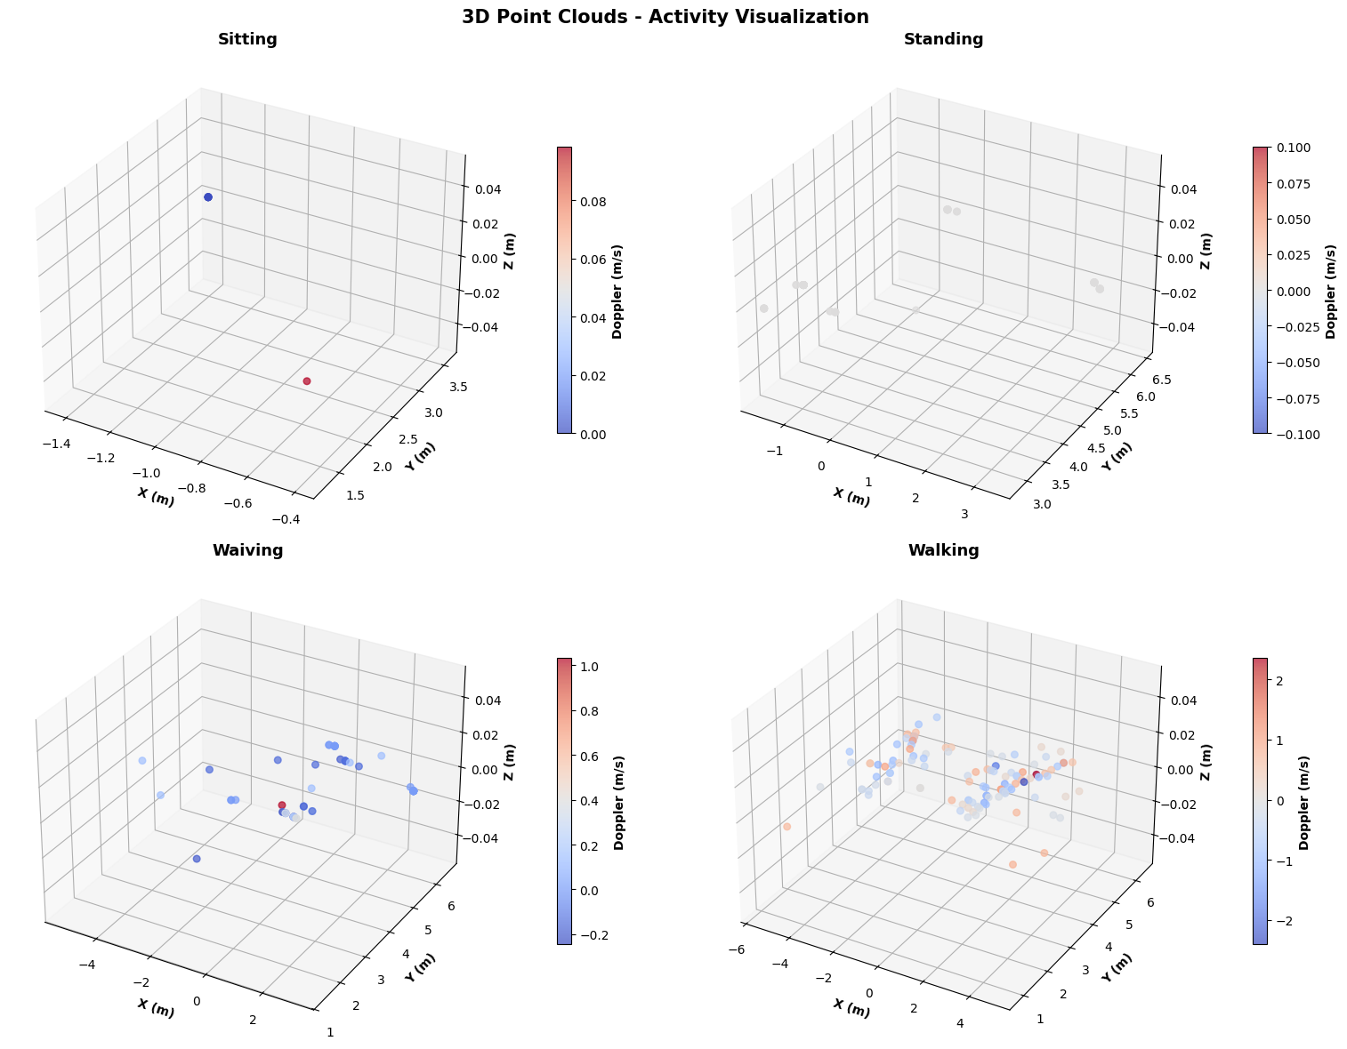
Single Activity Recognition (Point Cloud)

Slide 20
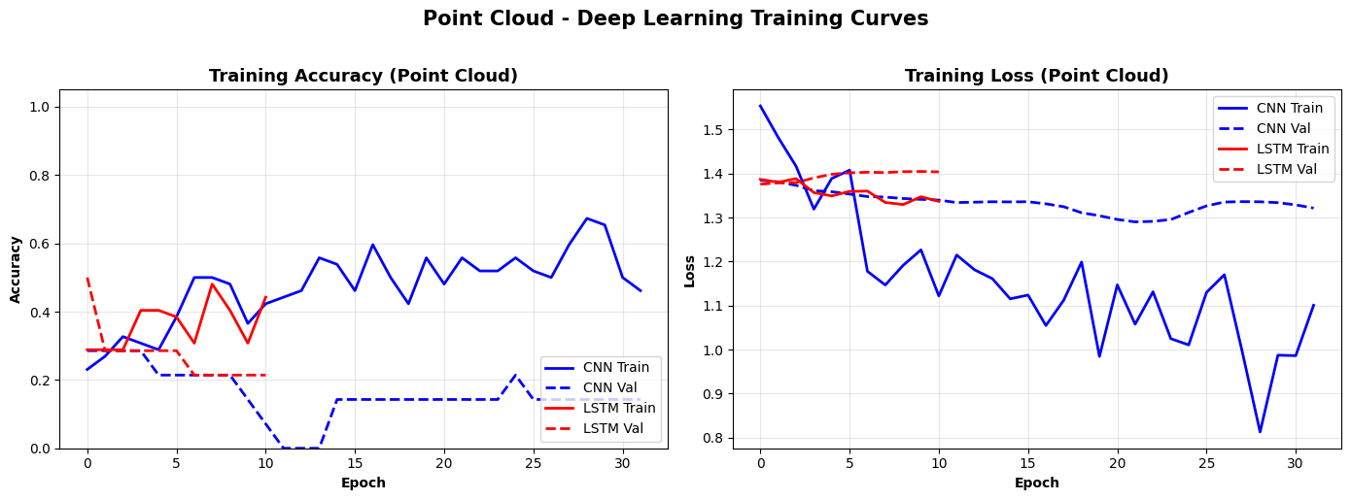
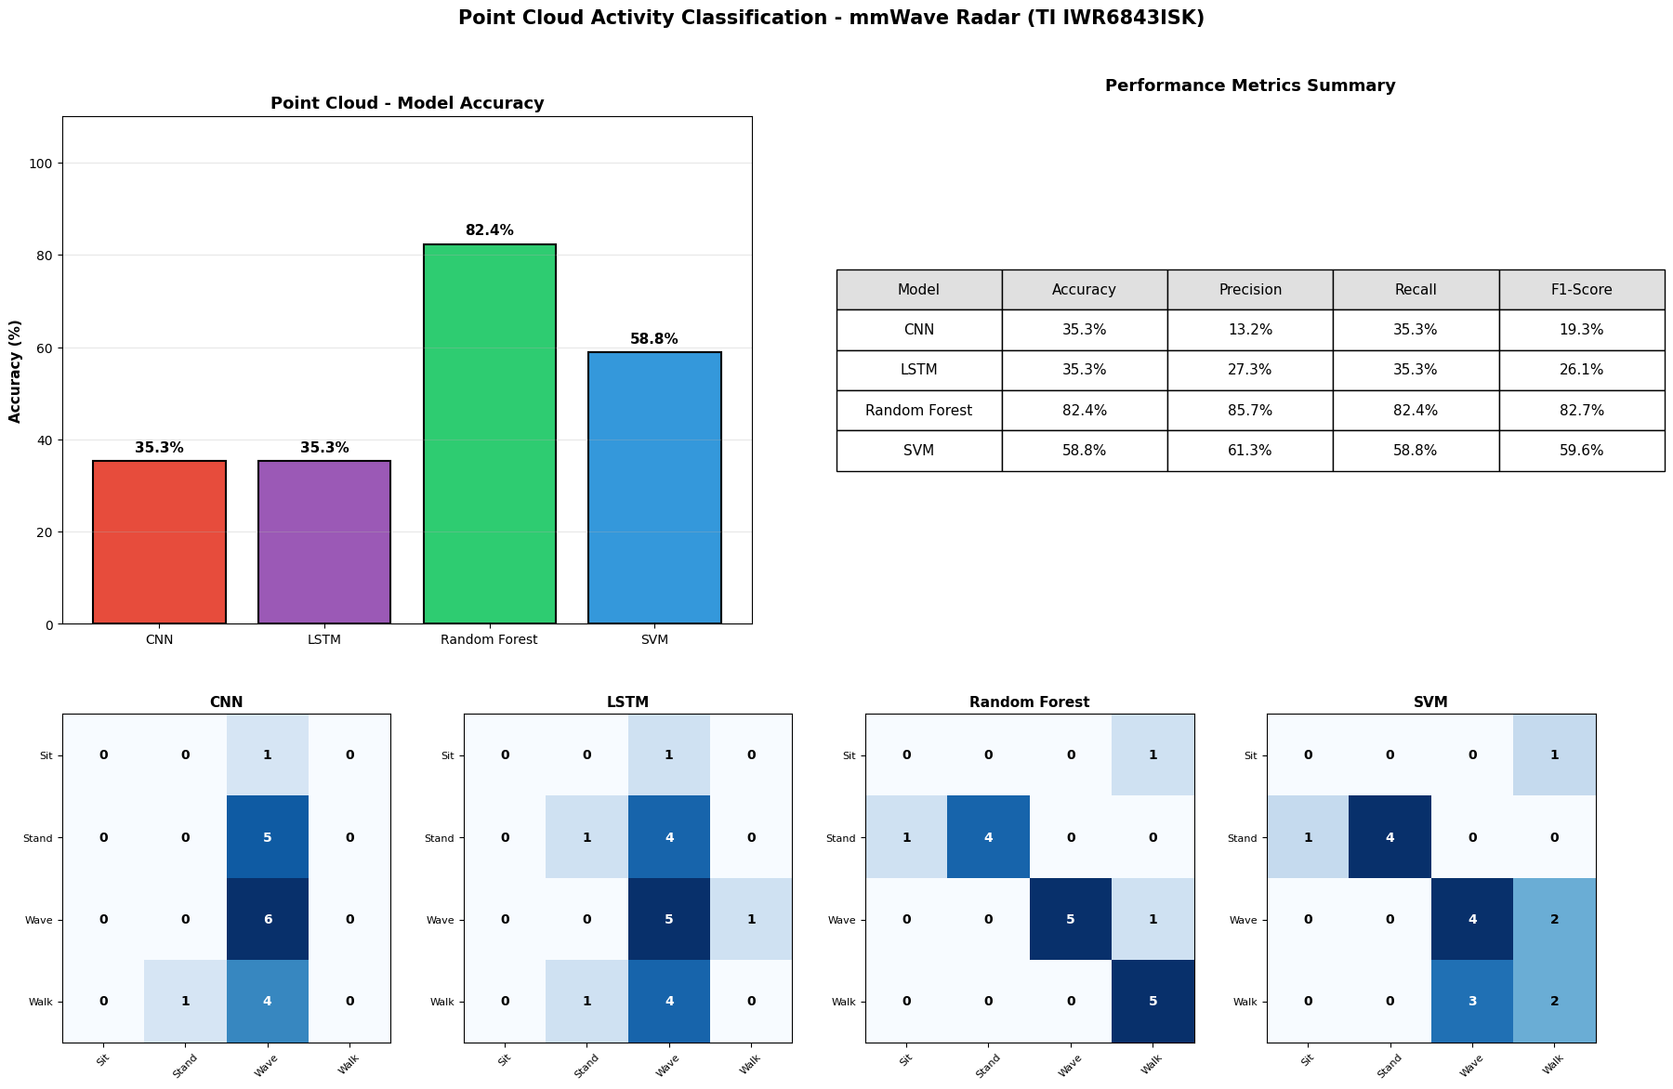
Preliminary Result

Slide 21
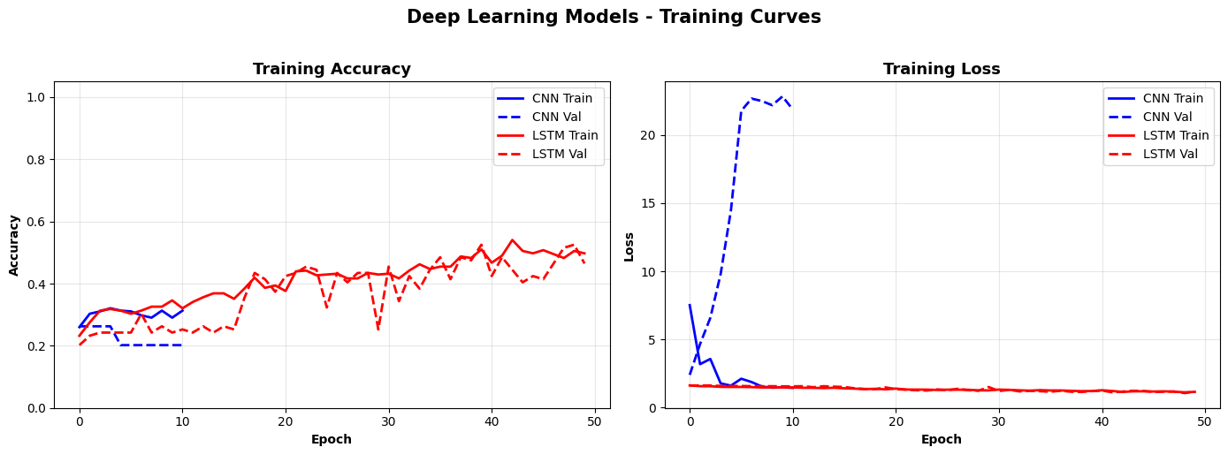
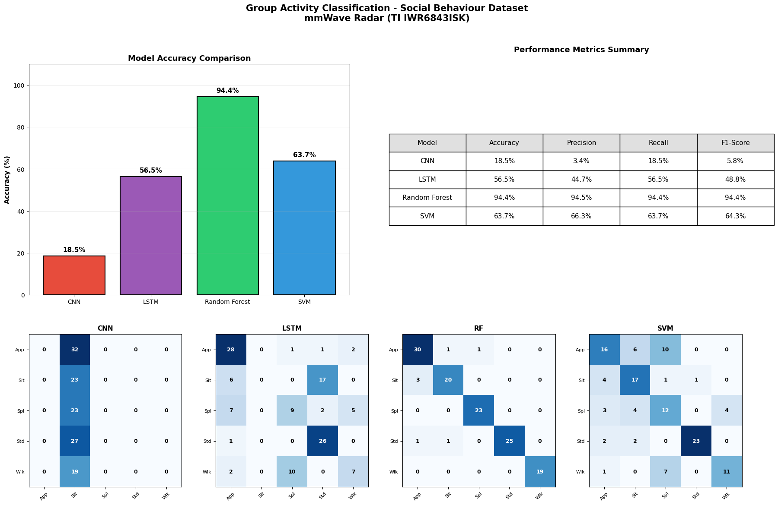
Social Activity Result

Slide 22
Model Preparation
Component | LSTM Model | CNN Model
Dataset Split | 80% Training, 20% Validation | 80% Training, 20% Validation
Loss Function | sparse_categorical_crossentropy | sparse_categorical_crossentropy
Optimizer (LR) | Adam (learning_rate=0.001) | Adam (learning_rate=0.001)
Epochs | 50 (with EarlyStopping, patience = 10) | 50 (with EarlyStopping, patience = 10)
Batch size | 32 | 32
Activations | LSTM: tanh + sigmoid gates; Dense: ReLU; Output: Softmax (5 classes) | Conv1D + Dense: ReLU; Output: Softmax (5 classes)
Regularization | Dropout = 0.3 (after each LSTM layer) | Dropout = 0.3 (after each LSTM layer)
Prediction threshold | N/A (softmax → argmax for class selection) | N/A (softmax → argmax for class selection)

Slide 23

Feature Vectorization
Frame Level processing $\left(x , y , z , v\right)$= lateral, depth, height, velocity
x_centroid
Locates group offset/center, important for multi-person positioning
y_variance
measures group’s depth consistency, useful in splitting/approaching detection
y_centroid
Helps distinguish Approaching vs. splitting
point_count
total reflections; proxy for group size (larger groups vs. pairs)
z_centroid
Distinguishes sitting vs. standing behaviors
low_height_ratio
fraction of reflections <1.2m; critical for detecting sitting discussions
x_range
Lateral spread; measures group width (tight vs. wide formation)
moving_point_ratio
fraction of reflections with |v|>0.1; detects active vs. static interactions)
y_range
Key for approaching vs splitting transitions
mean_velocity
distinguishes static discussions vs. moving together.

Slide 24
Future Work
Develop a real-time prediction system for supporting elderly care and assisted living
Try to add more micro activity in terms of social interaction
Integrate multi-sensor fusion (different mmwave radars) to enhance robustness and broaden activity classification

Slide 25
References
[1] A. K. Alhazmi, M. A. Alanazi, A. H. Alshehry, S. M. Alshahry, J. Jaszek, C. Djukic, A. Brown, K. Jackson, and V. P. Chodavarapu, “Intelligent millimeter-wave system for human activity monitoring for telemedicine,” [Journal/Conference name, vol., no., pp., year]. (please provide the exact venue details if available, since they weren’t listed in your text)
[2] Z. Li, J. Le Kernec, Q. Abbasi, F. Fioranelli, S. Yang, and O. Romain, “Radar-based human activity recognition with adaptive thresholding towards resource constrained platforms,” Scientific Reports, vol. 13, no. 3473, pp. 1–12, 2023
[3] F. Jin, R. Zhang, A. Sengupta, S. Cao, S. Hariri, N. K. Agarwal, and S. K. Agarwal, “Multiple patients behavior detection in real-time using mmWave radar and deep CNNs,” in Proc. IEEE Radar Conf. (RadarConf), Boston, MA, USA, 2019, pp. 1–6

Slide 26
If any suggestion

